Slide 1
Welcome Juniors!

Slide 2
So…if I want to know about you maybe you should know about me.

Slide 3
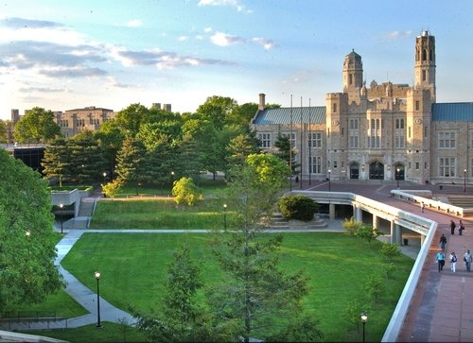
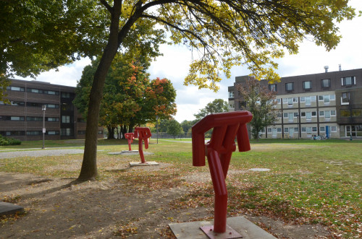
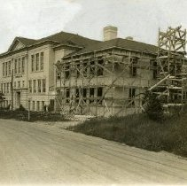
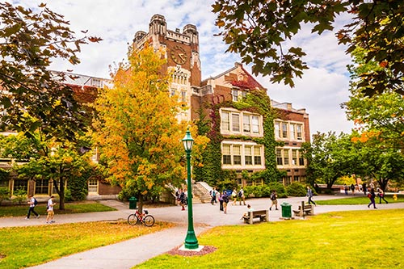
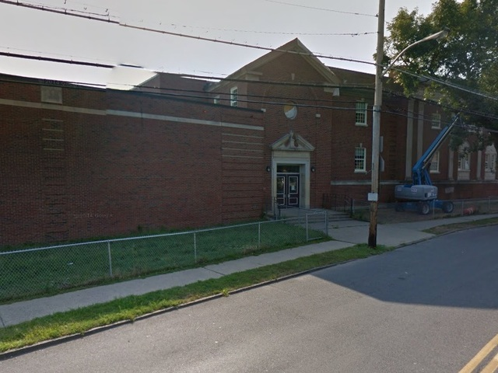
I went to school here and here and here! Can you recognize any of these places?

Slide 4
Who am I? Let me tell you a little about myself.
I grew up in Yonkers.
I went to PS 21 (on Lee Avenue in Bonkers)
I went to Mark Twain Middle School (Now Yonkers Montessori Academy)
I graduated from Lincoln High School
I went to SUNY Geneseo for 3 years
I Graduated with a BA in Biology from SUNY Purchase. My Senior project was about Lobsters.
I Graduated from Lehman College with a MA in Science Education.

Slide 5
Work
I started working at 13.
I delivered papers, was a lifeguard, worked in a catering hall, bussed and waited tables, worked in a college lab.
After graduation I did cancer research in three different labs; Cornell, Sloan Kettering and LIJ doing cancer research.
I started teaching in 1994 here at Saunders.

Slide 6
What else?
My wife grew up in Yonkers too. She grew up on Livingston and then moved to Riverdale Ave.
She went to Saint Mary’s and then graduated from Saunders. She was a Chem Tech Major!
She went to Manhattan College for 3 years and Graduated from Saint Johns University with a MS in Pharmacy.
We have one child who is 24, he went to Loyola University and received a BS in Mechanical Engineering.
We have a dog named Charlie.
I rode a motorcycle until my son was 2.

Slide 7
Let’s Play a game ☺…kind of. On your index card please answer 4 of the following: (You have to be ready to share these with the class)
What is your favorite TV show?
What is your spirit animal?
What is your favorite movie?
What is your favorite sport to watch?
What is your favorite song?
What is your favorite sport to play?
What is your favorite holiday?
What is your desert island food?
What is your favorite color?
Who is your hero?
What is your favorite book?
What is your favorite hobby?
What is your most prized possession?
If you could go anywhere in the world, where would you go?

Slide 8
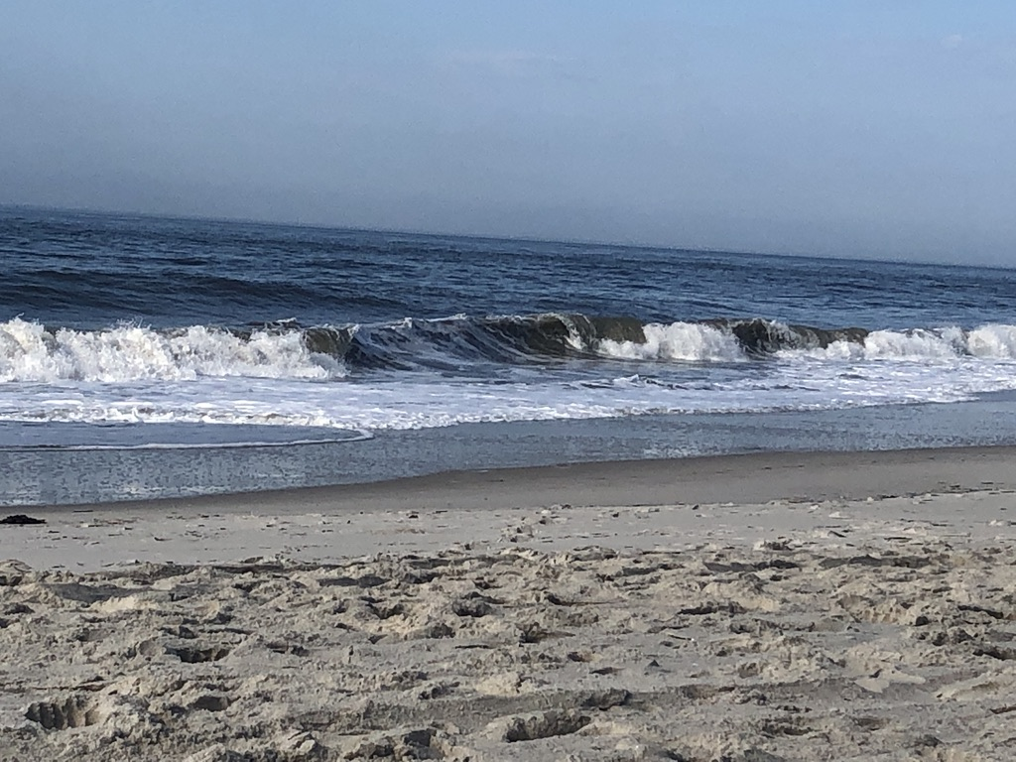
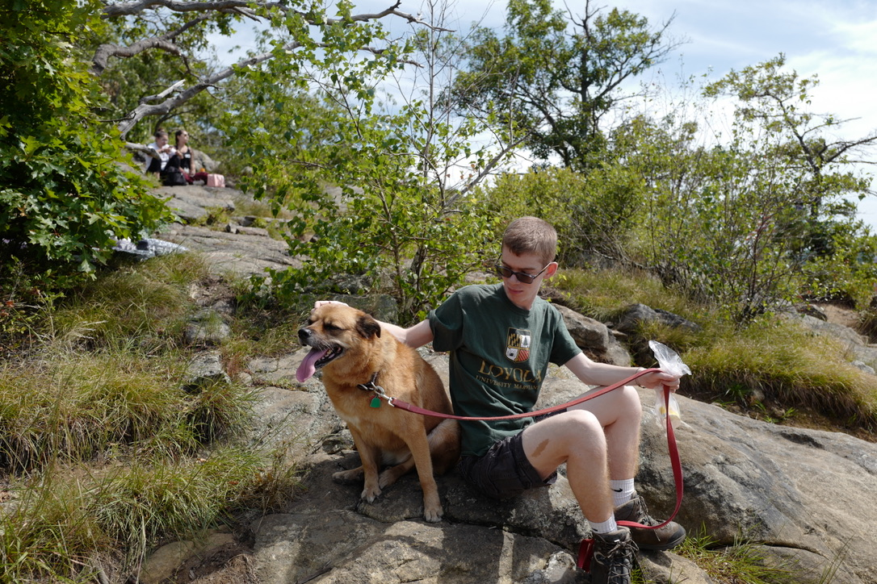

Slide 9
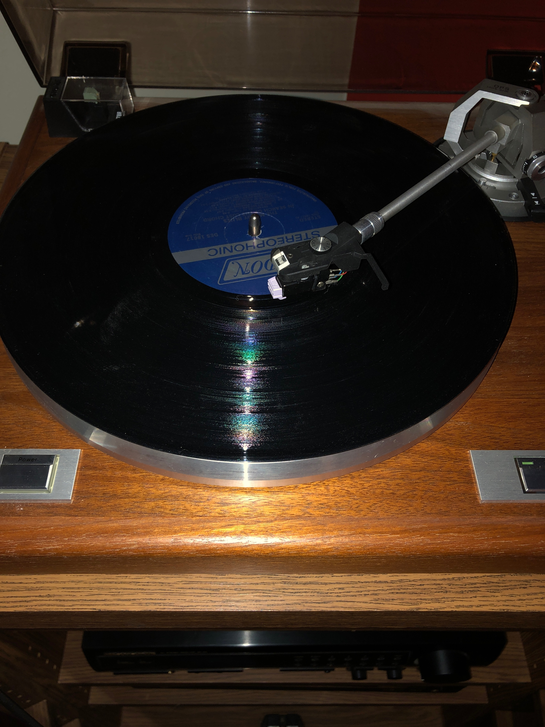
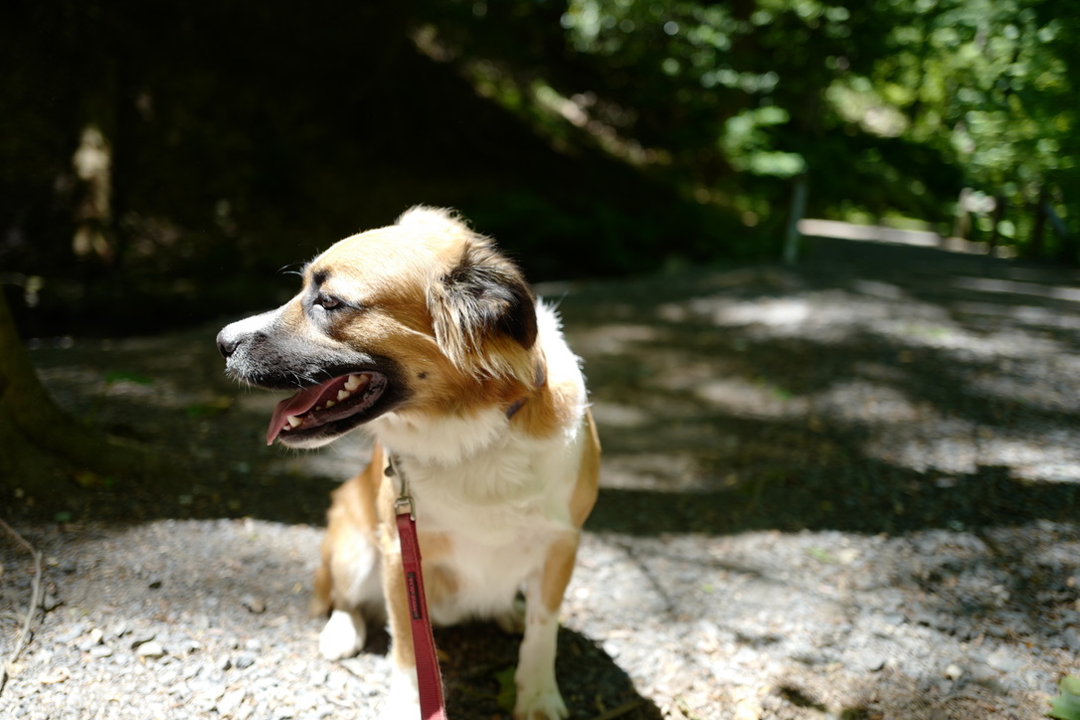

Slide 10
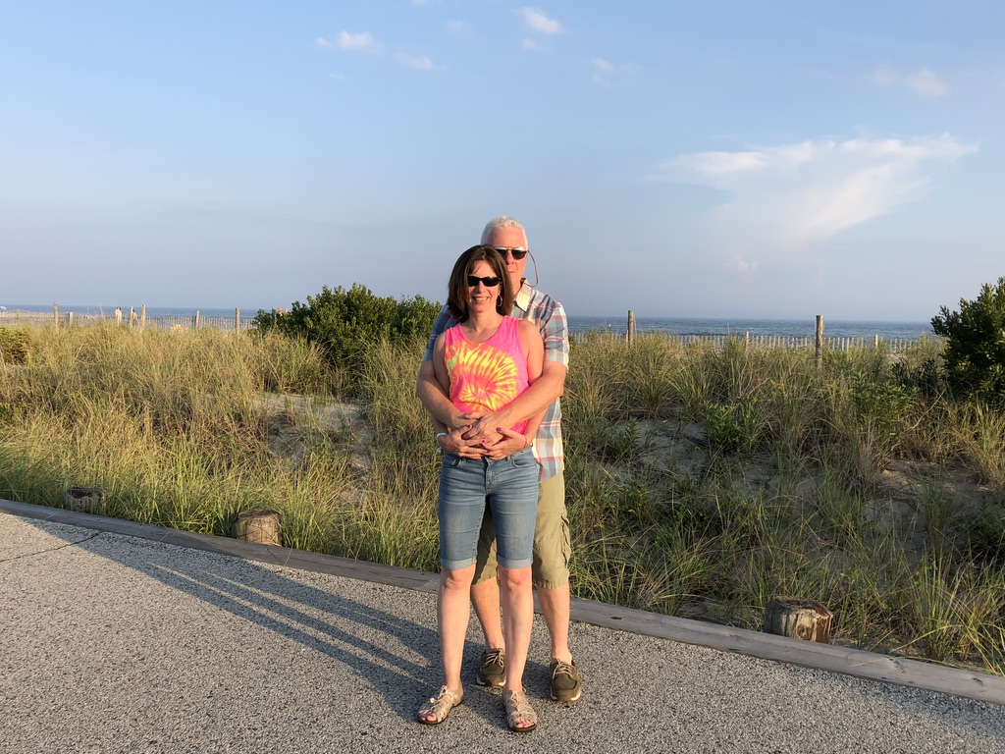

Slide 11
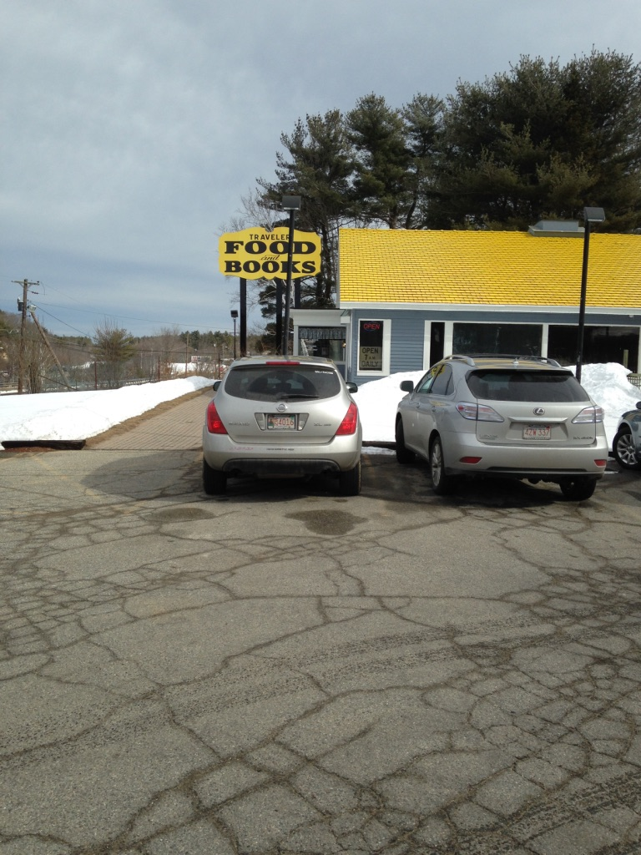
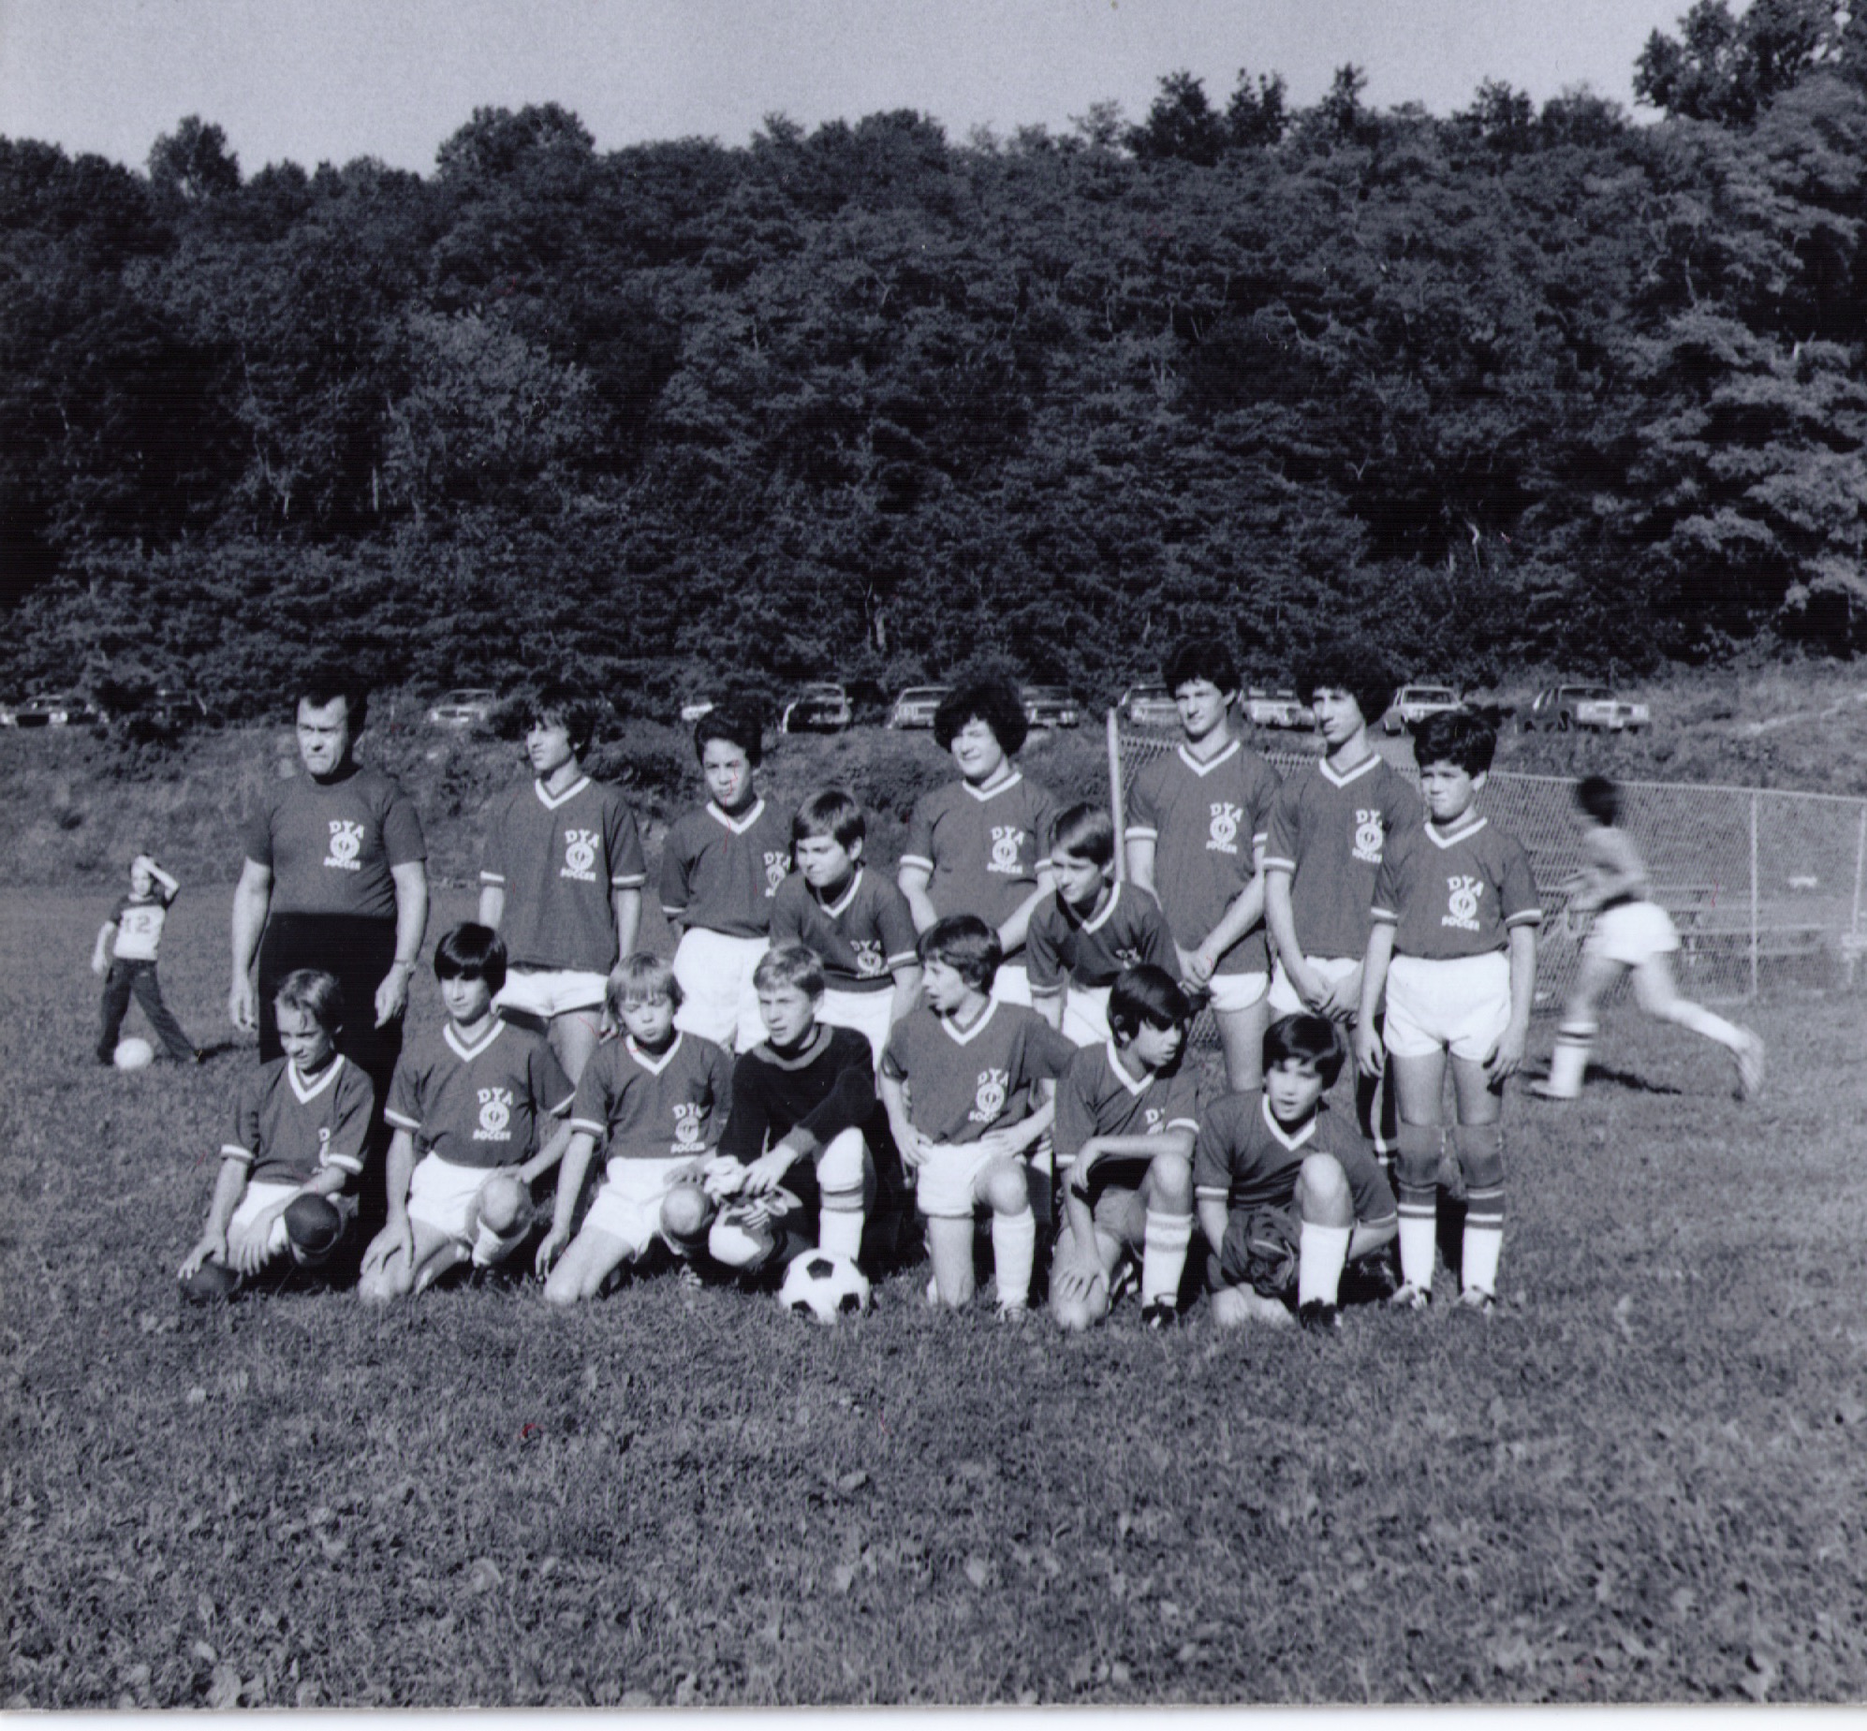

Slide 13
Now it is your turn… Who are you?
Fill out the student form
Every year I want to do better….
What are your goals for the year?

Slide 14
We are a Team! What do I think our goals should be?
To be scientists!
To have a thorough understanding of the scientific method.
To be able to function safely in a college or industrial lab setting.
To do meaningful research.
To develop a thorough understanding of molecular biology.
To see if you like science. ☺
To prepare you for the future.
To have fun.

Slide 15
Syllabus, Class Materials and Rules
I am using Schoolagy (the district wants us to use Schoology or power school). Your syllabus and class description are available on Schoology
I want you to get 3 notebooks; a marble lab notebook, a notebook for outlines and homework and a notebook or binder for class notes.
We are a team (unless you make it so we can’t be)
Lab coat, safety glasses and gloves. (and mask if you want)
Rules…BE KIND to one another, be safe, be respectful, be nerdy!
One person out of the class at a time, sign out and back in. Do not take the pass if you are going to be out for a while, ask me for a destination pass.
Did I mention we are a team?

Slide 16
CTE Hours…you need 55 ☺ It is not as hard as you think.
Work or volunteer in the field. Pharmacy tech, hospital, science barge, museum, doctor’s office, green team, eels, blue team. YOU MUST GET INSURANCE CERTIFICATE AND FORMS FILLED OUT.
In school opportunities include, lab maintenance for me or any other science teacher, hydroponics set up, trout tank, trout trip, freshman Friday…
Keep track of hours. Have supervisor sign WBL sheet.
Get 55 hours.
Get a stamp on your diploma*
* you must pass class, precision test and tech prep ☺

